Slide 1


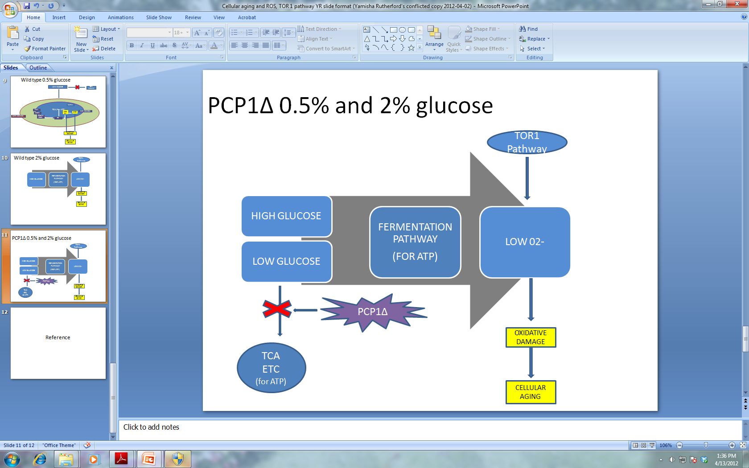
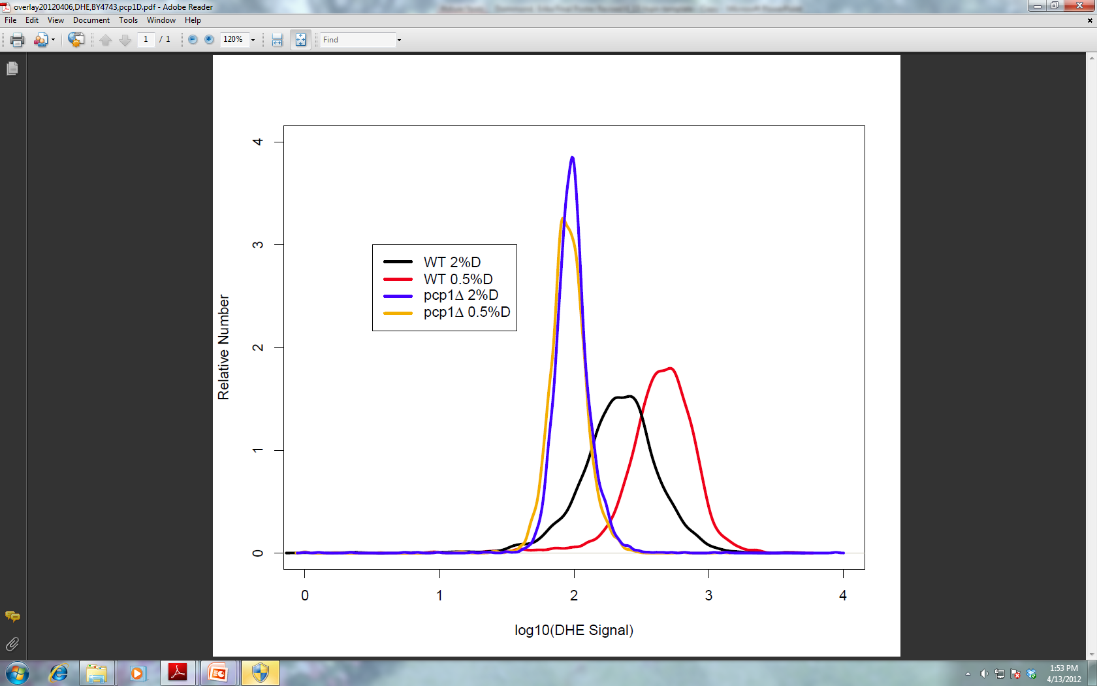
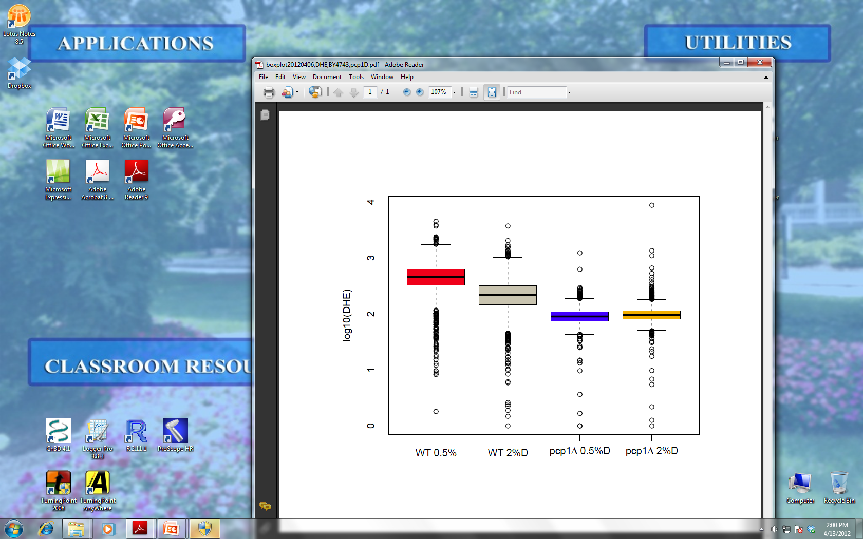
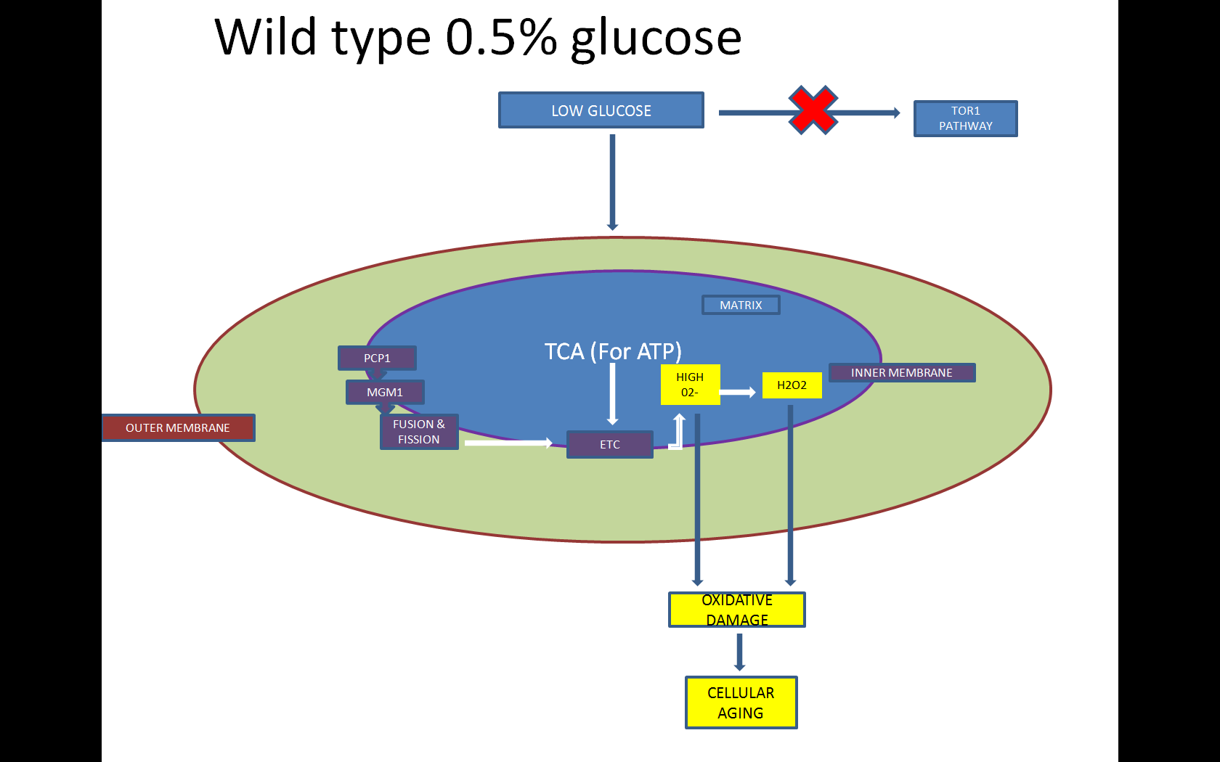
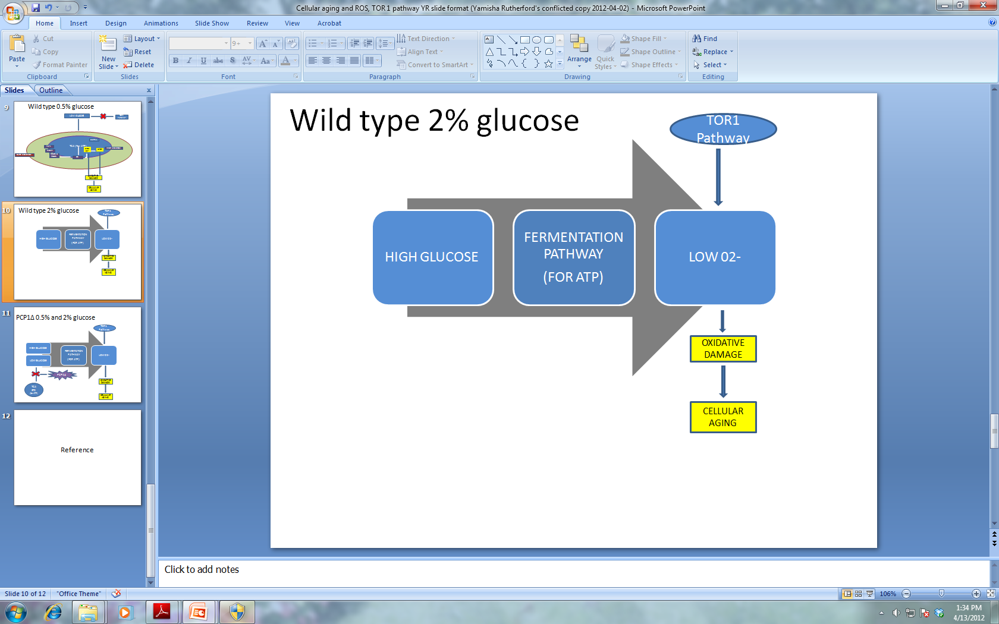
The affect of CR and the mechanism of mutant PCP1 gene cells on the longevity of yeast cells Yamisha Rutherford Dr. Hong Qin, Nilin Gupta Biology Department
Abstract
Mitochondria play a central role in life span extension effects of calorie restriction (CR). PCP1, a mitochondrial rhomboid serine protease, participates in mitochondrial dynamics and the processing of MGM1 a dynamin- like GTPase involved in mitochondrial fusion, fission and cristae formation. Deletion of PCP1 leads to extended replicative life span (RLS) and lower growth fitness. Therefore, we focused on the role of PCP1 to better understand the role of mitochondria in CR. We hypothesize that the effect of PCP1 on life span is due to its influences on the endogenous levels of superoxide. We test this hypothesis by comparing the superoxide levels between cells grown in normal conditions and calorie-restricted media, and then monitored the superoxide levels by dihydroethidium staining. Using flow cytometer, we found that CR induced higher superoxide levels in wild type cells during exponential growth. In contrast, cells of PCP1 deletion mutant show extremely low superoxide levels in both normal and CR media. These preliminary results suggest that the long RLS of pcp1∆ is due to its role in hindering the CAC and ETC’s ability to oxidize glucose and generate energy which then eliminates their healthy contribution to the production of high levels of O₂^{·-} . Results also suggest that CR would have no effect on the lifespan of pcp1∆. This study can potentially lead to more insights on ageing-related diseases in humans.
Method & Results
.∆Pcp1 and By4743 cells were exposed to 2% glucose and 0/5% glucose (CR).
Add PBS and DHE dihydroethidium to each sample.
Intracellular superoxide anions were measured via dihydroethidium DHE (Molecular Probes) signals using a FACSCaliber2 flow cytometer (BD-Biosciences) with a 488-nm excitation laser. Signals from 25,000 cells/sample were captured in FL3 (>670 nm) at a flow rate of 5,000 cells/s. In this step DHE is oxidized by the superoxide anions into ethodine. Ethodine can then bind to DNA which allows for the red fluoresce to be visualized.
Conclusion
When the pcp1d cells are in 0.5% glucose media they would normally use the CAC to convert glucose into energy but deleting PCP1 seems to impair the function of the mitochondria. Deleting PCP1 inhibits the processing of MGM1 which disturbs the structure of the inner member of the mitochondria where the CAC and ETC is. Consequently the CAC can not produce energy or (O₂⁻) and so even under low glucose condition the cell is forced to use fermentation to produce energy instead. Without a functional mitochondria CR does not work. When the pcp1d cells are in normal nutrient conditions deleting PCP1 is of no importance because the energy producing pathway is fermentation and so superoxide anion levels are low as well. In retrospect deleting PCP1 increases the longevity of the cells under calorie restricted conditions because it forces the cell to oxidize glucose by a pathway that produces less superoxide anions oppose to more.
When comparing the BY4743 wild type cells grown in normal medium with 2% glucose and.5% glucose there are higher DHE signals in those cells exposed to CR conditions. Contrarily Pcp1D has low DHE signals regardless of glucose concentration which indicates that CR does not work in ∆Pcp1 cells.
The CAC coupled with the ETC is effective in producing 36 to 38 ATP per molecule of glucose while fermentation only produces 2 ATP per molecule of glucose.
Figure A) When the wild type cell is under calorie restricted conditions (0.5% glucose ) the cell uses the CAC and ETC to oxidize and convert glucose into energy. The goal is to compensate for the energy output when there is a low level of glucose. Although this pathway generates more ATP it contributes more (O₂⁻) which is detrimental to the cells lifespan.
Figure B) While the wild type cell exposed to normal nutrient (2% glucose) partakes in the fermentation pathway to convert glucose into useful energy. When comparing this pathway to the CAC it contributes very little to the (O₂⁻) content.
Di
Discussion
References
.
Acknowledgements

